Slide 1
PCF 2.1 Updates
Chris Busch, Platform Architect
April, 2018

Slide 2
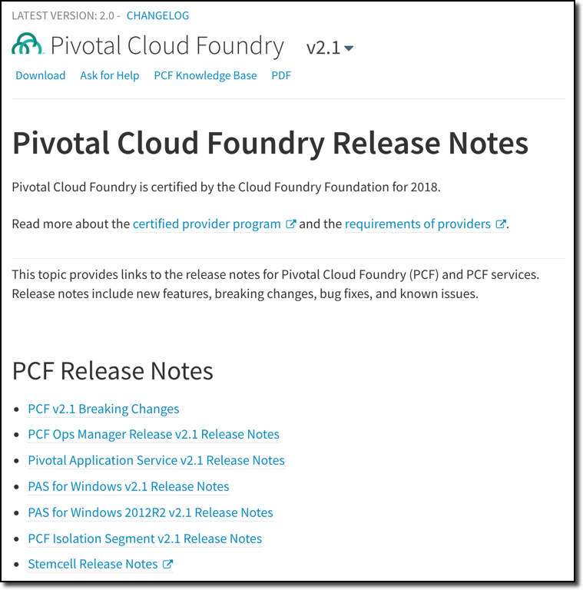
PCF v2.1 Release Notes
Always review before upgrading:
https://docs.pivotal.io/pivotalcf/2-1/pcf-release-notes/index.html

Slide 3
PCF v2.1
Ops Manager
Stemcell Library management in OM
Custom VM Extensions for IaaS-specific LB and security group implementations
CredHub Encryption Provider as internal or as external with Luna HSM
Multiple Read-Only Users Can Be Logged in Simultaneously
Create a Custom Banner in OM UI and SSH for altering operators
Add Multiple Clusters to Availability Zones
OM now leaves IP allocation to BOSH
Always review release notes before upgrading
https://docs.pivotal.io/pivotalcf/2-1/pcf-release-notes/opsmanager-rn.html

Slide 4
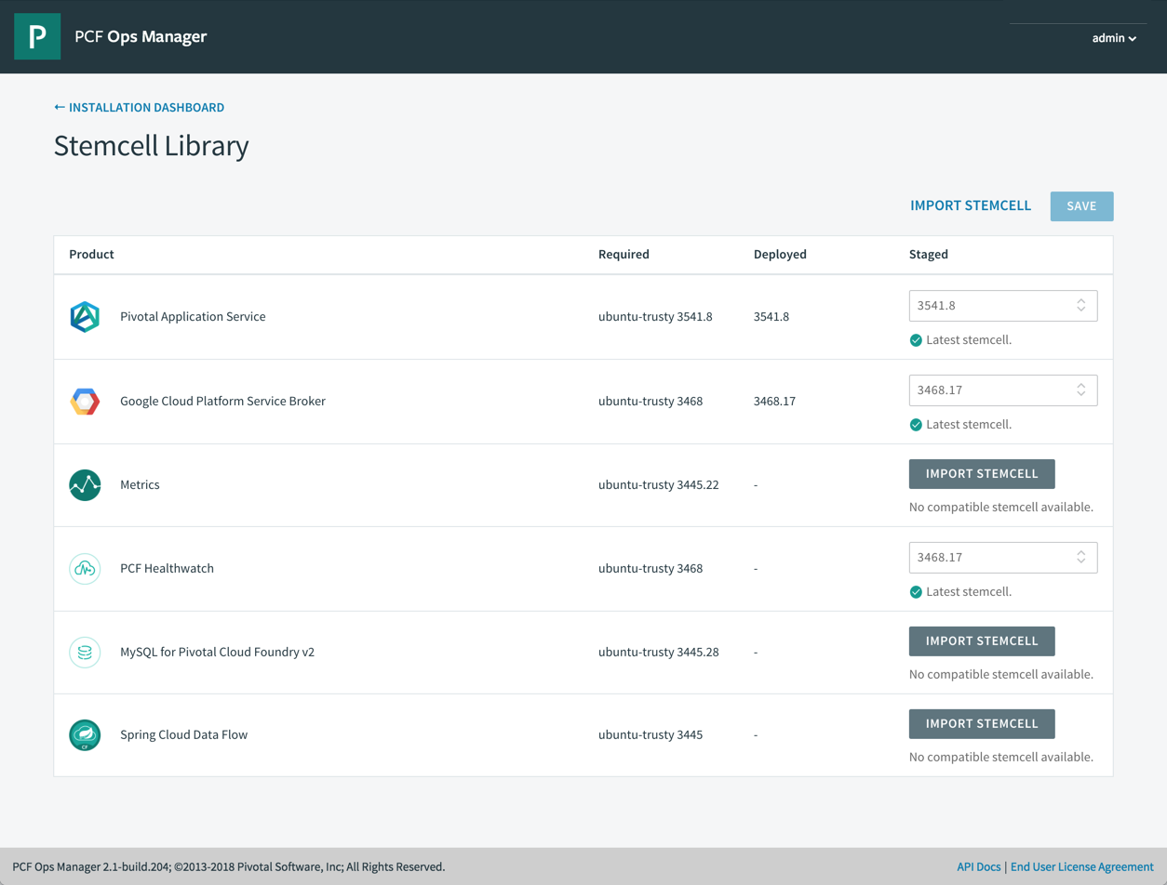
Ops Manager v2.1 Stemcell Library

Slide 5
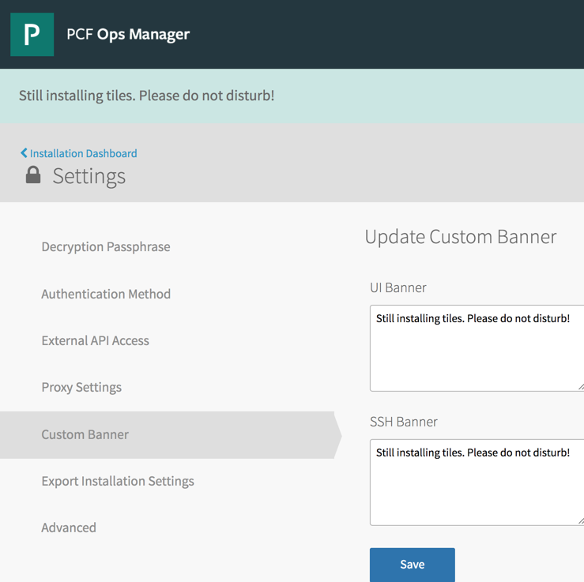
Ops Manager v2.1 Custom Banner

Slide 6
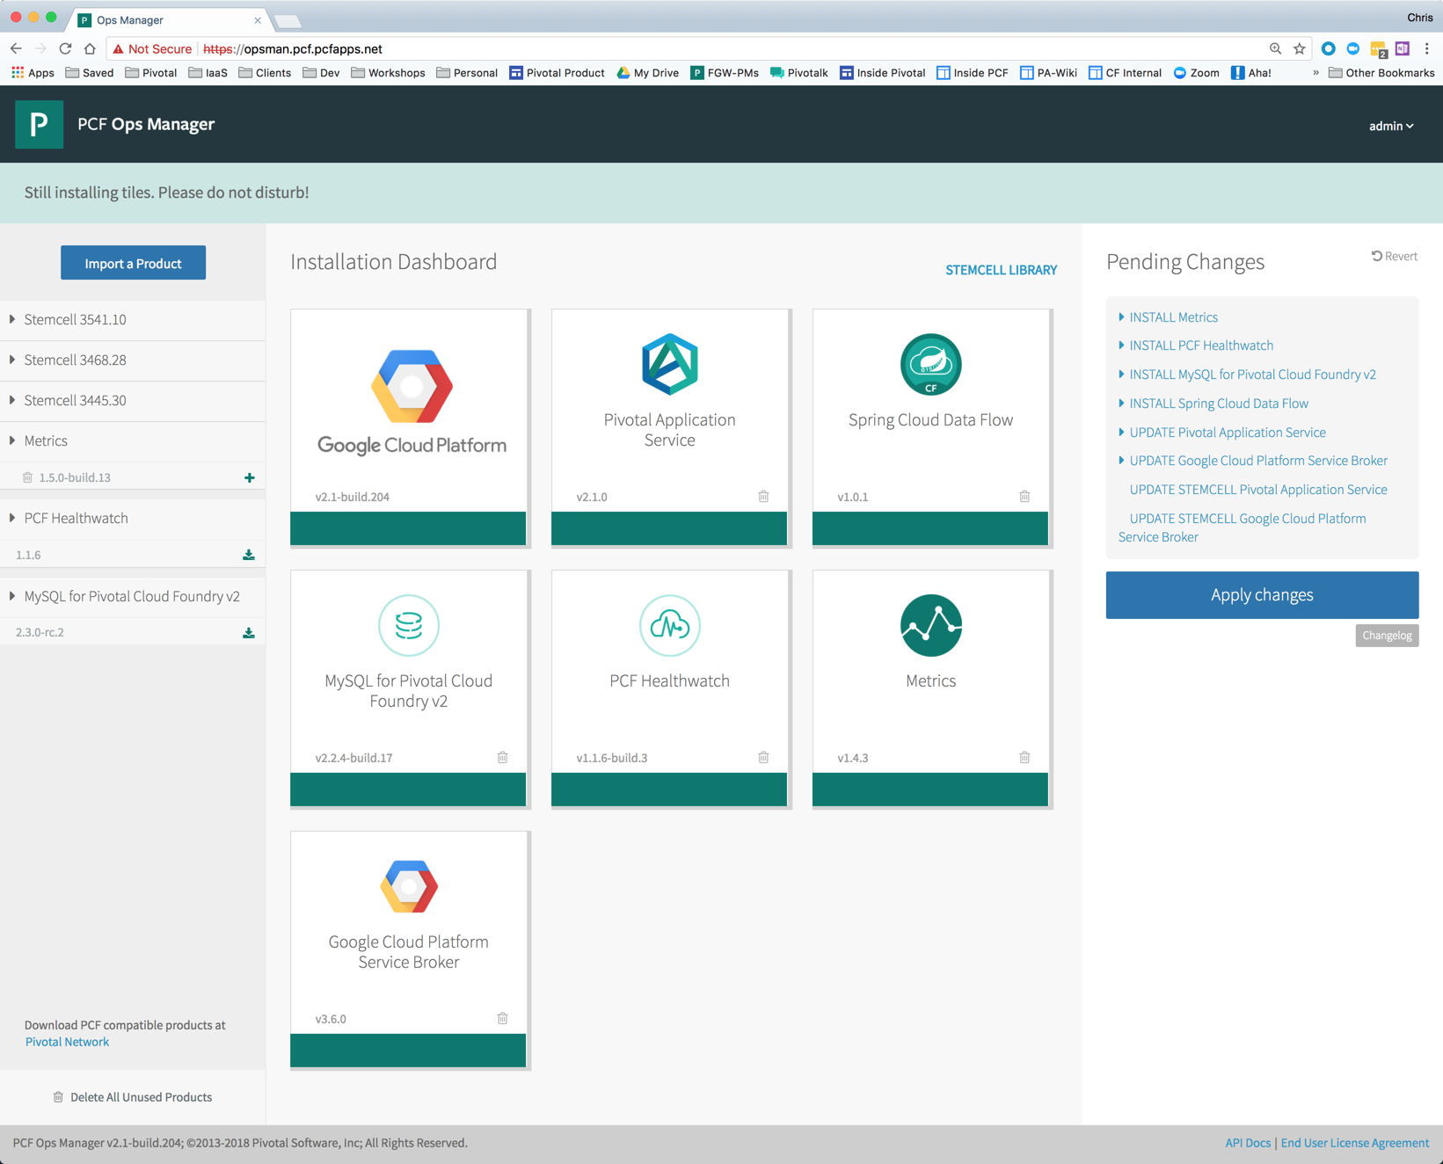
Ops Manager v2.1
Ready to install tiles

Slide 7
Pivotal Application Service 2.1
TLS connections to the application container (via Envoy)
App Autoscaler: new rule types & CLI plug-in
BBR supports external database and blobstore
Credhub can store encryption keys internally or using HSM providers
View and Scale Processes in Apps Manager
PCF Healthwatch includes events
Service instance sharing [beta]
Container-to-Container Service discovery [beta]
New features
Notes:
Here are some new features of the latest major version of PAS. We should note that many of these are a direct result of customer feedback and changing industry trends. Here are a few:
Windows 2016 containers
TLS connections to the application container (via Envoy)
Spring Cloud Data Flow for PCF
PCF Healthwatch includes events
App Autoscaler: new rule types & CLI plug-in
IaaS flexibility with custom vm_extensions
Service instance sharing [beta]
Platform-native service discovery for all frameworks [beta]
As you can see, the main feature areas for PAS 2.0 continue to evolve.

Slide 8
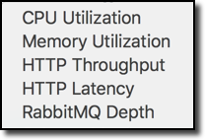
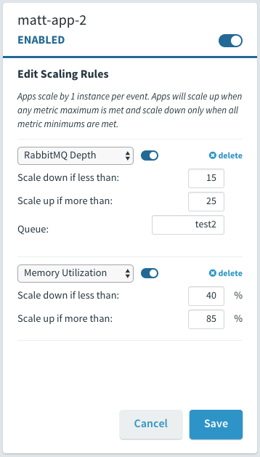
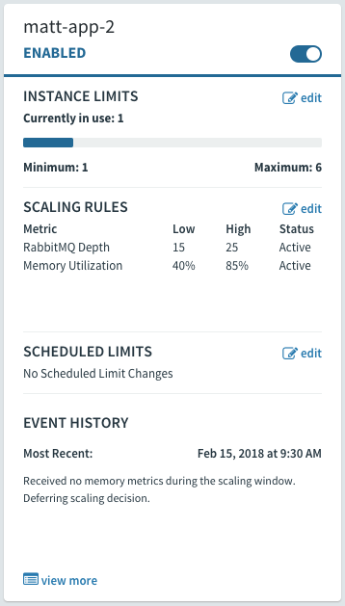
Manage Scaling with New App Autoscaler Metrics
App Autoscaler
Two New Autoscaling Rule Types [demo]
Container Memory Utilization: The average RAM percentage used for all instances of the app.
RabbitMQ Depth: The length of a specified RabbitMQ queue.
http://docs.pivotal.io/pivotalcf/2-1/appsman-services/autoscaler/using-autoscaler.html#config

Slide 9

The future
org1
space1
space2
rabbit1
janes_ app
rabbit1
johns_ app
cf bind-service
cf bind-service
service instance
application
service instance (shared)
application
Hey Jane, my app needs to receive messages from your rabbit queue
cf create-service
No worries John! You should be able to see it now. Go ahead and create your binding.
cf share-service rabbit1 org1 space2
Awesome! Thanks! :)

Slide 10
PAS for Windows
Windows 2016 Runtime Tile for a smooth upgrade experience from 2012R2 to 2016
Windows 2016 containers
Support for Windows Server Core stemcells
Unlocks the potential for the newest PCF platform features for an on-par experience with Linux applications
CPU + network limits
CPU-based autoscaling
CredHub encrypted service creds
Diego SSH (i.e. cf ssh)
Improved performance over 2012R2
Includes Windows Server Containers offered on Windows Server 2016
Notes:
There has always been a divide been the Windows and Linux camps, which has traditionally resulted in organizations having to support one or both platforms, in completely different ways. Pivotal has taken the opposite tact - to embrace Windows development and runtime as a first-class citizen. The offering of a Windows tile, fully supported, managed by BOSH, and offering feature parity with Linux rounds out the platform as complete. Now the same management and monitoring of applications running in the Linux world is available to Windows, and our team will continue to enhance and deliver on the promise of developer choice, platform, and language independence.

Slide 11
HealthWatch 1.2
Events & Alerting
Alerting. KPI/KSI out of the box Alerts with configuration of shipped thresholds
Isolation Segments. Handling impacts to Healthwatch super-metrics produced; Impacts to Healthwatch UI
Data. Data Store & Data Aggregation Improvements
Eliminate creation of service network requirement for production installation.
PCF Healthwatch publishes events. Subscribers can receive messages (email, Slack, webhook) on KPI thresholds in Healthwatch.
Configure Event Alerts is via a CF CLI plugin.
Example: Healthwatch publishes a warning event when BOSH system memory is greater than 80% and a critical event when greater than 90% link to Healthwatch docs, Platform operators can now subscribe to Healthwatch’s system.mem.percent topic and receive warning and critical messages via email, Slack or webhook integration when these events occur.
Current v1.1.6 with v1.2 to be released
Notes:
https://pcf.aha.io/products/PMON/feature_cards

Slide 12
PCF Metrics v1.5
Alerting on app metrics [beta]
Setup monitors for metrics, events
Support for webhook notifications
Reduce logs storage VM footprint by switching to Postgres
Optimized metrics and logs ingestion performance
Current v1.4.3 with v1.5 now in selective beta
Notes:
https://pcf.aha.io/products/AMTRCS/feature_cards

Slide 13
Spring Cloud Data Flow for PCF
OSS SCDF 1.3
UAA Integration
cf CLI plugins simplify service instance management & aggregate app telemetry
Simple service instance setup (via Service Broker)
Works with PCF data tiles (MySQL, Redis, RabbitMQ)
Works with public cloud data services (Azure SQL Database, GCP’s BigQuery), plus on-prem sources
Build Flexible Data Pipelines
Notes:
https://content.pivotal.io/blog/building-flexible-data-pipelines-with-spring-cloud-data-flow-for-pcf

Slide 14
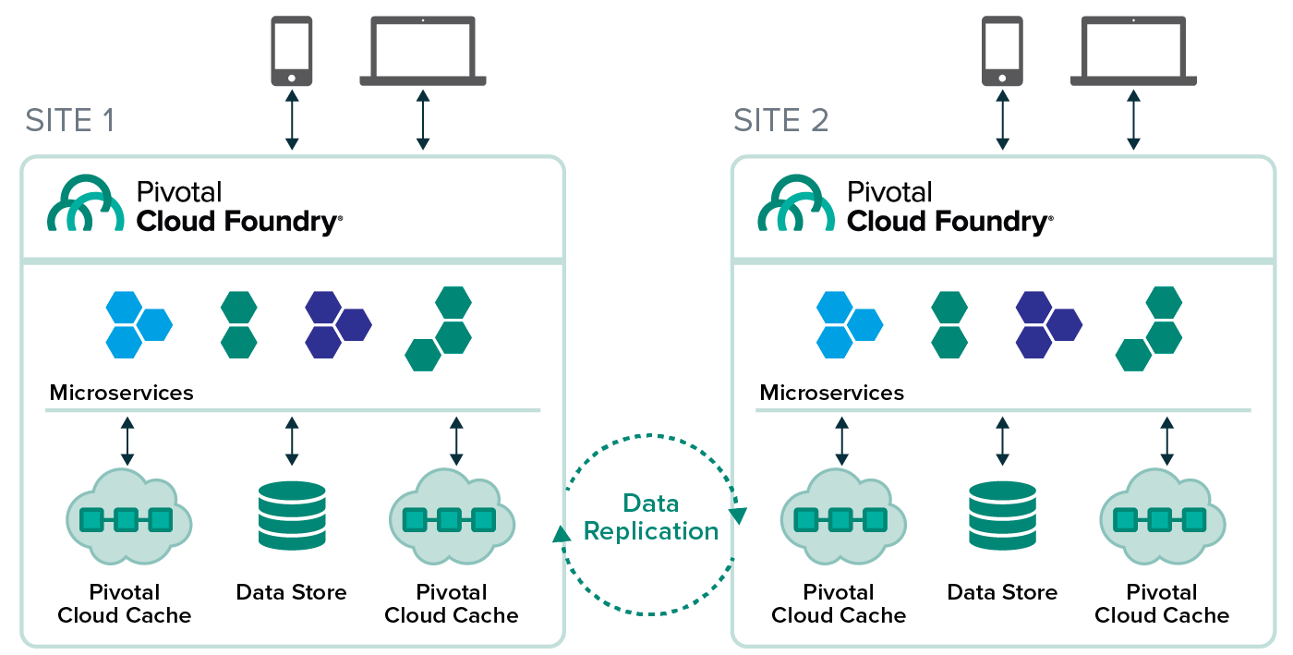
Pivotal Cloud Cache 1.3
WAN Replication
Notes:
Other highlights:
Cross DC data sharing in PCC BOSH can rotate IPs without rebinding Eliminate use of Ops Manager IPAM Whitelist gfsh commands which are allowed to avoid snowflakes PCC running on PWS-E Integrate memory usage statistics to OpsManager report Elastic Runtime can drop its hard dependency on Consul in favor of BOSH DNS Ensure compliance with new UAA get/post

Slide 15

Transforming How The World Builds Software
© Copyright 2017 Pivotal Software, Inc. All rights Reserved.

Slide 16
PCF v2.1
Ops Manager
Stemcell Library
Create Custom VM Extensions
AWS KMS Encryption Available for BOSH and Ops Manager VMs
Configure an External CredHub Encryption Provider
Multiple Read-Only Users Can Be Logged in Simultaneously
Create a Custom Banner
GCS Blobstore Available for External File Storage
Integrate Azure Application Gateway Load Balancers
Add Multiple Clusters to Availability Zones
IP Address Management (IPAM) Removed
Expand Your Network with Additional Subnets
VPC Verifier Removed from AWS Configuration
Associate AWS ALBs with Jobs
Always review release notes before upgrading
https://docs.pivotal.io/pivotalcf/2-1/pcf-release-notes/opsmanager-rn.html

Slide 17
PCF v2.1
Pivotal Application Service (PAS)
Support for S3 Server-Side Encryption with AWS KMS
BBR Backs Up External S3 Versioned Blobstores
BBR Supports External Databases
Cloud Controller Blobstore on GCS Supports Service Accounts
Increased Resiliency, Consistency, and Security for HTTP Routing
Gorouter Keepalive Connections to Back Ends Enabled by Default
HSTS Support for HAProxy
Pre-Populated TLS Cipher Defaults for Gorouter and HAProxy
Enable PROXY Protocol Support in CF Router
Naming a Service Binding
Runtime CredHub Can Use HSMs
Always review release notes before upgrading
https://docs.pivotal.io/pivotalcf/2-1/pcf-release-notes/runtime-rn.html

Slide 18
PCF v2.1
Pivotal Application Service (PAS)
12. Improved System Performance for App Health Checks
13. Custom SAML Entity ID for Tiles
14. cf CLI Errors on Multi-Origin User Ambiguity
15. Apps Manager Introduces the Enter JSON Toggle
16. View and Scale Processes in Apps Manager
17. App Autoscaler Metrics
18. App Autoscaler CLI
19. Stage a Droplet on a Stopped App
20. Container Metrics Included in Syslog Drains
21. GrootFS Is Merged with Garden and Enabled by Default
22. Noisy Neighbor Nozzle
23. Selector-Based Subscription Model and Reference Nozzle
24. Service Instance Sharing (Beta)
Always review release notes before upgrading
https://docs.pivotal.io/pivotalcf/2-1/pcf-release-notes/runtime-rn.html

Slide 19
PCF v2.1
PAS for Windows
CF SSH
Full Autoscale Support
Context Path Routing
Support for URL Rewrite Module
CPU Shared Limits for Containers
App Instance Limits
Improved System Performance for App Health Checks
Always review release notes before upgrading
https://docs.pivotal.io/pivotalcf/2-1/pcf-release-notes/windows-rn.html

Slide 20
PCF v2.1
Isolation Segments
Increased Resiliency, Consistency, and Security for HTTP Routing
Gorouter Keepalive Connections to Back Ends Enabled by Default
HSTS Support for HAProxy
Pre-Populated TLS Cipher Defaults for Gorouter and HAProxy
Improved System Performance for App Health Checks
Always review release notes before upgrading
https://docs.pivotal.io/pivotalcf/2-1/pcf-release-notes/segment-rn.html

Slide 21

BOSH
for PCF 2.1
All CPIs support instance-type selection based on desired resources (will enable CPIs to determine instance types rather than Ops Manager)
Support for IPv6 on vSphere (full IPv6 support in PCF will require many non-BOSH changes as well)
Ubuntu 16.04 stemcell available on all cloud providers, ready for consumption by tiles
Agents on latest stemcells can talk to built-in BOSH Blobstore over TLS (with non-TLS fallback for older stemcells)
Fast stemcell upgrade in multi-CPI-config case for OM multi-CPI-config support (expected in PCF 2.2)
Umask settings in stemcells more secure
Release Target: March 2018
Notes:
https://pcf.aha.io/products/BOSH/feature_cards

Slide 22
PCF v2.1 Breaking Changes
Pivotal Application Service (PAS)
Removal of Automated Backup Configuration for Internal MySQL
PAS for Windows Requires Injector Step
Ops Manager
None
PCF Isolation Segment
None
https://docs.pivotal.io/pivotalcf/2-1/pcf-release-notes/breaking-changes.html

